Slide 1

Action Search: Spotting Actions in Videos and Its Application to Temporal Action Localization
Humam Alwassel*, Fabian Caba Heilbron*, Bernard Ghanem
King Abdullah University of Science and Technology (KAUST), Saudi Arabia
ECCV 2018
* Equal contribution

Slide 2
We propose the new problem of action spotting in video, which we define as finding an action instance in a video sequence while observing a small portion of that video.

Slide 3
We argue that action spotting is an efficient and effective precursor to temporal action localization and a departure from the focus of traditional precursors such as proposals.

Slide 4
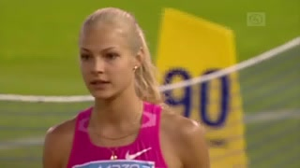
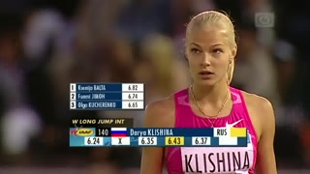
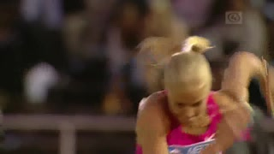
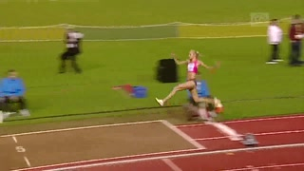
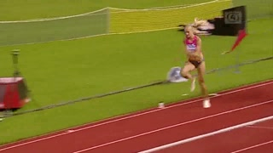
t = 15 sec
t = 42 sec
t = 59 sec
t = 67 sec
t = 63 sec
Video Time
Spotting Target
Task: Find the beginning of a Long Jump action
18
19
20
21
22
Human Search Step
Consider the search sequence a human observer performs when asked to find the beginning of a Long Jump in a long video.

Slide 5
t = 15 sec
t = 42 sec
t = 59 sec
t = 67 sec
t = 63 sec
Video Time
Spotting Target
Task: Find the beginning of a Long Jump action
18
19
20
21
22
Human Search Step
This sequence reveals that the person can quickly find the target (in 22 search steps) without observing the entire video, which indicates the possible role temporal context plays in searching for actions.

Slide 6
t = 15 sec
t = 42 sec
t = 59 sec
t = 67 sec
t = 63 sec
Video Time
Spotting Target
Task: Find the beginning of a Long Jump action
18
19
20
21
22
Human Search Step
Inspired by this efficiency, we seek to mimic the search process of humans to solve the action spotting problem.

Slide 7
However, we first conduct two experiments using Amazon Mechanical Turk workers (Turkers) to get insights on how humans search for target actions in videos.

Slide 8
FIRST EXPERIMENT: We present Turkers different target search tasks:
a single class search to find one instance of a given action class, and
a multiple class search to find one instance from a larger set of action classes

Slide 9
As compared to single class search, Turkers observed 190% and 210% more frames when asked to find an action instance among 10 and 20 action classes, respectively.
This observation motivates our intuition that action search can be performed more efficiently when the task is simpler (i.e. it incorporates a smaller number of classes).

Slide 10
SECOND EXPERIMENT: To compare action spotting with action localization, we ask Turkers to find the starting time of single target actions in videos. We note that Turkers tend to first spot the action and then refine its temporal boundaries.

Slide 11
Interestingly, while searching, Turkers perform three times more search steps to refine the temporal boundaries of an action, as compared to the number of search steps needed for spotting the same action.

Slide 12
This observation motivates our intuition that action spotting can be performed more efficiently than action localization, especially when target instances are short in duration and sparse in frequency within a video.

Slide 13
To address the absence of data recording the behavior of human annotators, we put forward the Human Searches dataset, a new dataset composed of the search sequences of human annotators for the AVA and THUMOS14 datasets.

Slide 14
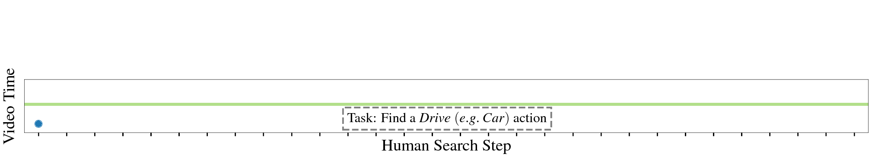
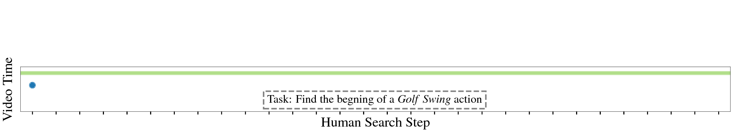
This new dataset contains the search step sequences of human annotators like the ones shown above (top from AVA searches dataset; bottom from THUMOS14 searches dataset).
* Shaded green area is where the spotting target of the given task occurs in the video.

Slide 15
Using this new dataset, we propose Action Search, a novel Recurrent Neural Network approach that mimics the way humans spot targets in untrimmed videos.

Slide 16
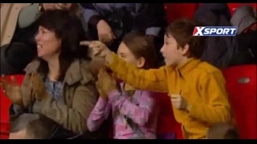
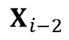
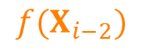
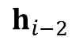
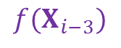
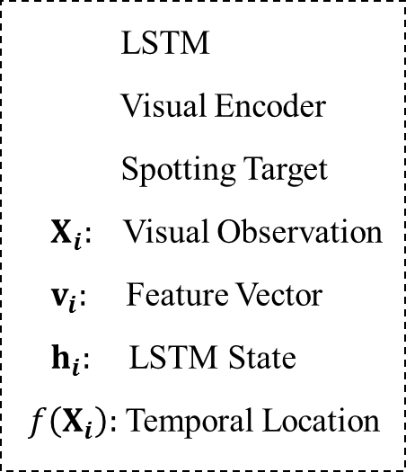
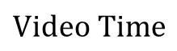
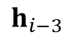
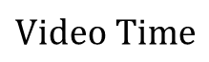
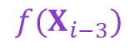
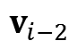
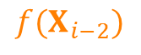
$$Video Time$$
$${f(X}_{i−3})$$
$${f(X}_{i−2})$$
. . .
LSTM
Visual Encoder
Spotting Target
$X_{i}:$Visual Observation
$v_{i}:$ Feature Vector
$h_{i}:$ LSTM State
$f\left(X_{i}\right):$ Temporal Location
$$h_{i−3}$$
$$h_{i−2}$$
$$v_{i−2}$$
. . .
$$X_{i−2}$$
$${f(X}_{i−3})$$
$${f(X}_{i−2})$$
$$Video Time$$
Our model harnesses the temporal context from its current location in the video and the history of what it has observed to predict the next search location in the video.
At each step,
(i) a visual encoder transforms the visual observation extracted from the model's current temporal location to a representative feature vector;
(ii) an LSTM consumes this feature vector along with the state and temporal location produced in the previous step;
(iii) the LSTM outputs its updated state and the next search location in the video;
(iv) the model then moves to this new temporal location, repeating the process.

Slide 17
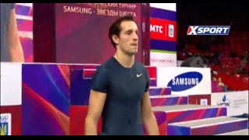
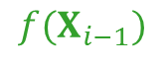
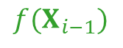
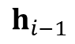
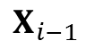
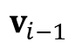
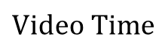
$$Video Time$$
$${f(X}_{i−3})$$
$${f(X}_{i−2})$$
$${f(X}_{i−1})$$
. . .
LSTM
Visual Encoder
Spotting Target
$X_{i}:$Visual Observation
$v_{i}:$ Feature Vector
$h_{i}:$ LSTM State
$f\left(X_{i}\right):$ Temporal Location
$$h_{i−3}$$
$$h_{i−2}$$
$$h_{i−1}$$
$$v_{i−2}$$
$$v_{i−1}$$
. . .
$$X_{i−2}$$
$$X_{i−1}$$
$${f(X}_{i−3})$$
$${f(X}_{i−2})$$
$${f(X}_{i−1})$$
$$Video Time$$
(i) a visual encoder transforms the visual observation extracted from the model's current temporal location to a representative feature vector;
(ii) an LSTM consumes this feature vector along with the state and temporal location produced in the previous step;
(iii) the LSTM outputs its updated state and the next search location in the video;
(iv) the model then moves to this new temporal location, repeating the process.

Slide 18
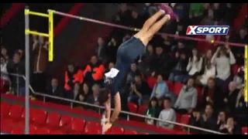
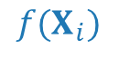
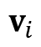
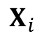
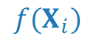
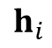
$$Video Time$$
$${f(X}_{i−3})$$
$${f(X}_{i−2})$$
$${f(X}_{i−1})$$
$${f(X}_{i})$$
. . .
LSTM
Visual Encoder
Spotting Target
$X_{i}:$Visual Observation
$v_{i}:$ Feature Vector
$h_{i}:$ LSTM State
$f\left(X_{i}\right):$ Temporal Location
$$h_{i−3}$$
$$h_{i−2}$$
$$h_{i−1}$$
$$h_{i}$$
$$v_{i−2}$$
$$v_{i−1}$$
$$v_{i}$$
. . .
$$X_{i−2}$$
$$X_{i−1}$$
$$X_{i}$$
$${f(X}_{i−3})$$
$${f(X}_{i−2})$$
$${f(X}_{i})$$
$${f(X}_{i−1})$$
$$Video Time$$
(i) a visual encoder transforms the visual observation extracted from the model's current temporal location to a representative feature vector;
(ii) an LSTM consumes this feature vector along with the state and temporal location produced in the previous step;
(iii) the LSTM outputs its updated state and the next search location in the video;
(iv) the model then moves to this new temporal location, repeating the process.

Slide 19
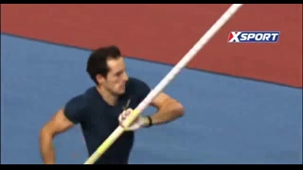
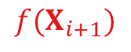
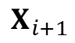
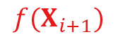
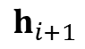
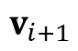
$$Video Time$$
$${f(X}_{i−3})$$
$${f(X}_{i−2})$$
$${f(X}_{i−1})$$
$${f(X}_{i})$$
$${f(X}_{i+1})$$
. . .
. . .
LSTM
Visual Encoder
Spotting Target
$X_{i}:$Visual Observation
$v_{i}:$ Feature Vector
$h_{i}:$ LSTM State
$f\left(X_{i}\right):$ Temporal Location
$$h_{i−3}$$
$$h_{i−2}$$
$$h_{i−1}$$
$$h_{i}$$
$$h_{i+1}$$
$$v_{i−2}$$
$$v_{i−1}$$
$$v_{i}$$
$$v_{i+1}$$
. . .
. . .
$$X_{i−2}$$
$$X_{i−1}$$
$$X_{i}$$
$$X_{i+1}$$
$${f(X}_{i−3})$$
$${f(X}_{i−2})$$
$${f(X}_{i+1})$$
$${f(X}_{i})$$
$${f(X}_{i−1})$$
$$Video Time$$
(i) a visual encoder transforms the visual observation extracted from the model's current temporal location to a representative feature vector;
(ii) an LSTM consumes this feature vector along with the state and temporal location produced in the previous step;
(iii) the LSTM outputs its updated state and the next search location in the video;
(iv) the model then moves to this new temporal location, repeating the process.

Slide 20
We conduct two experiments:
(1) Action Search for Action Spotting: to validate our model for action spotting problem
(2) Action Search for Action Localization: to demonstrate the benefits of action spotting as precursor to temporal action localization.

Slide 21
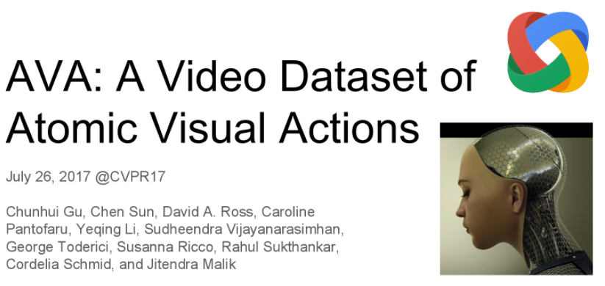
AVA Dataset
15 Action Categories
15 Minutes Videos
139 Training Videos
35 Testing Videos
Action Search for Action Spotting: We conduct this experiment using the subset of the AVA dataset, which is among the largest annotated action datasets and is composed of feature films. We pick 15 action categories out of the original 80 set of actions. We use AVA 3-second annotations to define temporal boundaries for each action instance.

Slide 22
AVA Dataset
15 Action Categories
15 Minutes Videos
139 Training Videos
35 Testing Videos
We compare our model against other approaches according to the action spotting metric, which we define to be the expected number of observations made per video until spotting an action. An action is spotted if the model lands anywhere between its ground truth temporal bounds.

Slide 23
AVA Dataset
15 Action Categories
15 Minutes Videos
139 Training Videos
35 Testing Videos
We train our model using the collected AVA searches from our Human Searches dataset described in Section 3 of the paper.

Slide 24
We validate Action Search for the action spotting problem by demonstrating that it requires on average 16.6% and 22.3% fewer observations to successfully spot an action than the Direction Baseline and Random Baseline, respectively.

Slide 25

20 Action Categories
3.5 Minutes Videos (Avg.)
200 Training Videos
213 Testing Videos
Action Search for Action Localization: We conduct this experiment using the THUMOS14 dataset, which is one of the most popular datasets for temporal localization and is composed of sports videos.

Slide 26
20 Action Categories
3.5 Minutes Videos (Avg.)
200 Training Videos
213 Testing Videos
We train our Action Search model to spot the start time of actions using the THUMOS14 searches dataset described in Section 3.

Slide 27
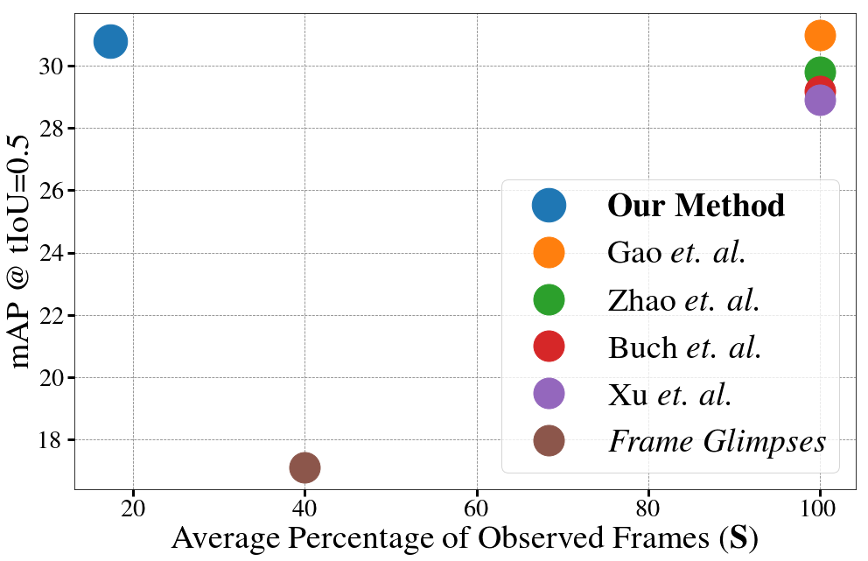
Opting for simplicity, we build our action detector by combining Action Search with action length priors and a pretrained off-the-shelf classifier. This straightforward approach allows us to achieve state-of-the-art mAP performance, while observing 17.3% of video frames.

Slide 28
We conduct an ablation study to investigate two aspects of our model:
(i) the backbone architecture for the Action Search visual encoder and the off-the-shelf classifier
(ii) the trade-off between the Action Search training size and performance in terms of mAP and S.

Slide 29
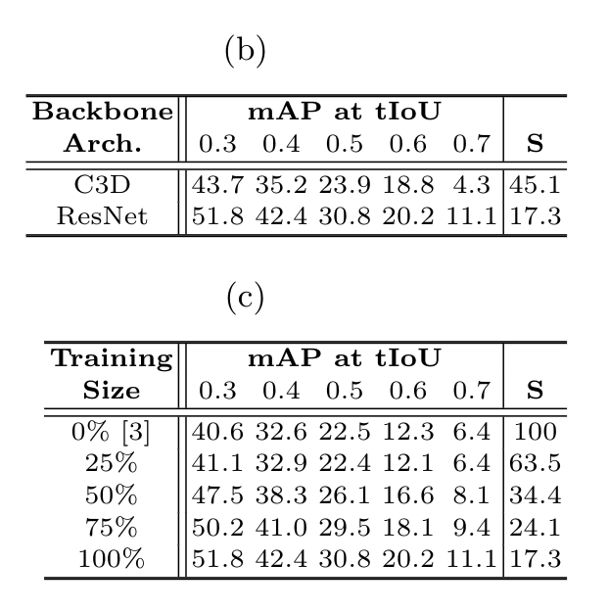
Backbone Architecture. We observe that C3D improves the performance of the C3D-based detector baseline [21] by 4.9% mAP (0.5 tIoU) while observing 54.9% less frames. However, we observe ResNet offers better results in both mAP and S.

Slide 30
Action Search Training Size. Training Action Search on even half of the THUMOS14 searches dataset (i.e. 4.4 human searches per video) improves the detection performance by 3.6% mAP (0.5 tIoU) while observing only S=34.4% of the frames.

Slide 31
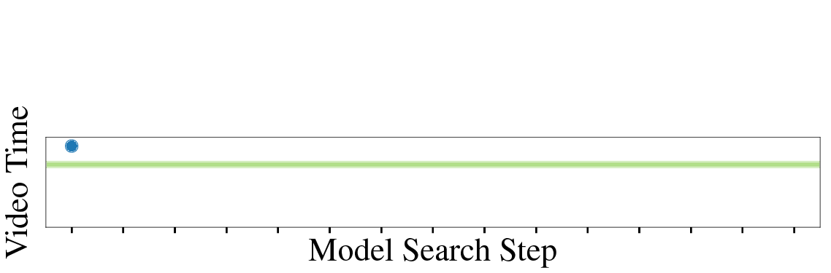
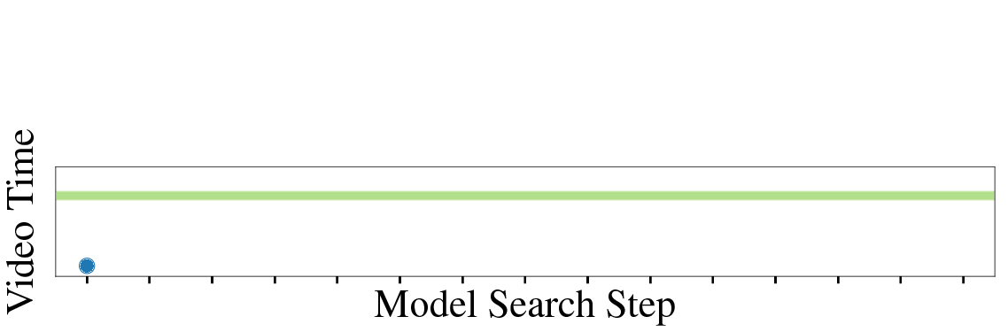
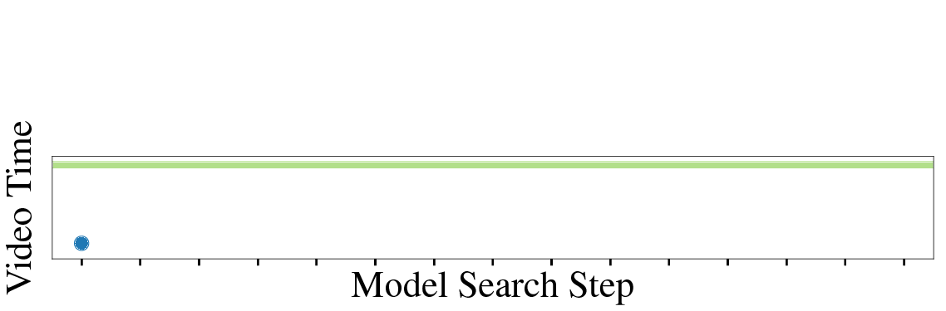
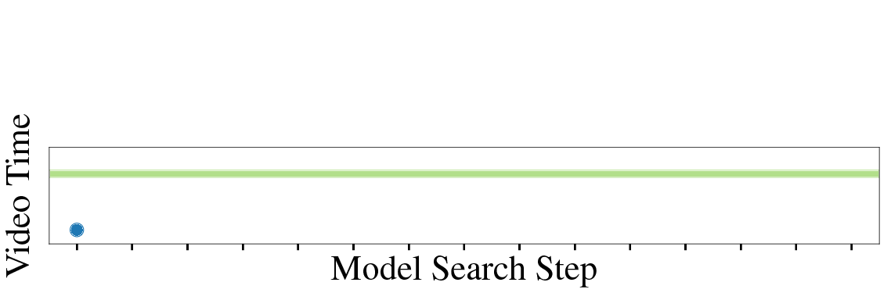
Our model seems to understand the inherent temporal structures of actions when spotting the start times of actions. Bottom right: Action Search surprisingly understands when an action finishes and is able to rewind (jump back) and spot the beginning of the action.
* Shaded green area is where the spotting target occurs in the video.
Our model can exploits the temporal context to spot actions quickly.
Top row: It uses information about scenes/concepts such as gala dinner and fights to spot actions such as clink glass and shoot, respectively
* Shaded green area is where the spotting target occurs in the video.

Slide 32
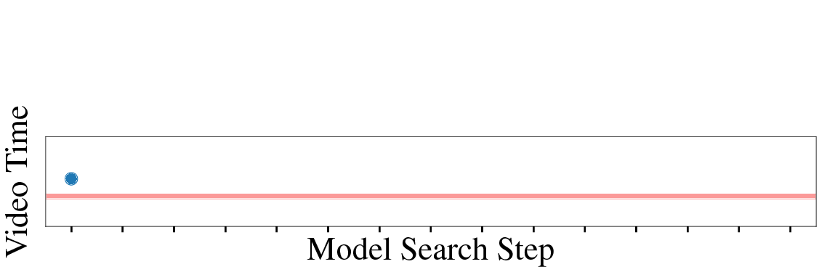
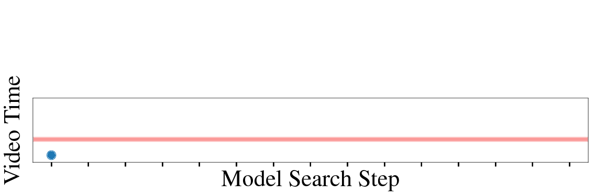
Left: Typical failure cases (action is not spotted) occur when the search sequences oscillate around the target action but they miss its exact location.
* Shaded red area is where the spotting target occurs in the video.
Right: When our model finds content visually similar to the target action, it remains static during few search steps and then decides to explore the video further. In those cases, the model keeps exploring the video till the end without finding the action of interest.
* Shaded red area is where the spotting target occurs in the video.

Slide 33
Action Search: Spotting Actions in Videos and Its Application to Temporal Action Localization
Humam Alwassel*, Fabian Caba Heilbron*, Bernard Ghanem
King Abdullah University of Science and Technology (KAUST), Saudi Arabia

